Slide 1
Courant Math 2799.001
Modeling & Risk Mgt of Bonds & Securitized Products
Lecture 1: Dimensions of Risk, Intro, Whole Loan Mortgages
March 25, 2024
Prof: Rodney Sunada-Wong rsw8@nyu.edu
TA: Edison Lee el2700@nyu.edu

Slide 2
Topics
Your Experiences
Dimensions of Risk
Some history
recessions, the Federal Reserve, and the Yield Curve
The Futures-Cash basis Trade
What is a mortgage?
Risk#1: Credit Risk
Mortgage-Backed Securities
U.S. Fixed Income securities markets
Mortgage Loan Basics
Risk#2a: Interest Rate Risk (bond duration and convexity)
Risk#2b: Prepayment Risk
Homework
APPENDIX: History

Slide 3
Topics
Two polls
Academic experience with bonds, mortgages or MBS
Work experience with bonds, mortgages or MBS

Slide 4
The key dimensions of risk for bonds
For bonds
Interest rate
Duration
Yield Curve shape
Convexity / non-linearity
Basis
Credit risk
Liquidity risk
We will try to discuss parts of these each week.

Slide 5
Slope of yield curve
Campbell Harvey thesis paper (1989):
“Forecasts of Economic Growth from the Bond and Stock Markets”
His paper suggests that a negatively sloped yield curve is a predictor of recession
https://www.ssc.wisc.edu/~mchinn/Harvey_yieldcurve_FAJ1989.pdf

Slide 6
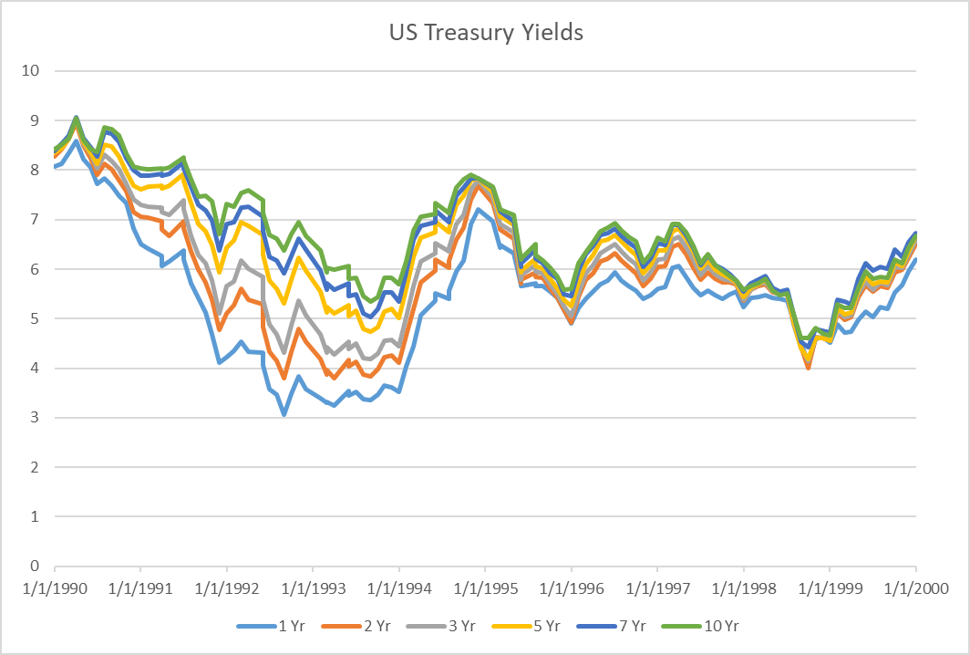
Treasury yield curve history 1990 - 2000
Yield curve was flat at the beginning of the recession July 1990 - March 1991
FRB began cutting rates; By late 1992, significantly upward sloping
FRB began raising rates 1994
Source: https://www.treasury.gov/resource-center/data-chart-center/interest-rates/Pages/TextView.aspx?data=yield
Spreadsheet “US Treasury Yield History and Recessions YYYYMM.xls in Columbia directory”

Slide 7
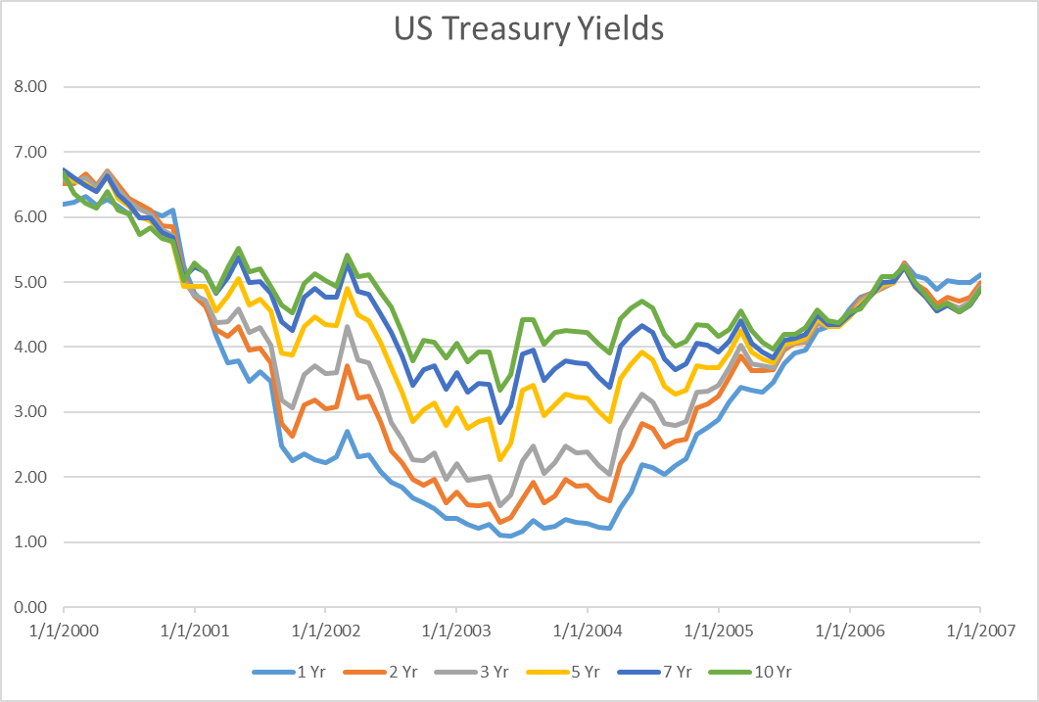
Treasury yield curve history 2000 - 2007
Yield curve was flat / inverted before the recession March 2001 - Nov 2001;
The Federal Reserve Board (FRB) cut rates beginning 2001
Yield curve significantly upward sloping 2002 / 2003
Fed began raising rates in 2004
Inverted!
Inverted!
Source: https://www.treasury.gov/resource-center/data-chart-center/interest-rates/Pages/TextView.aspx?data=yield
Spreadsheet “US Treasury Yield History and Recessions YYYYMM.xls in Columbia directory”

Slide 8
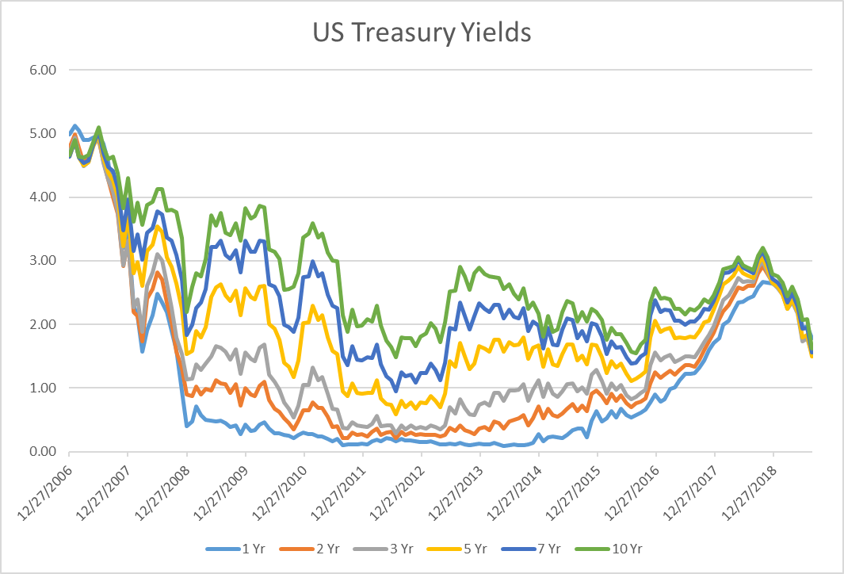
Treasury yield curve history 2007 - 2019
Yield curve was flat / inverted for mths before the recession Dec 2007 - June 2009;
2007-2008, the FRB cut Fed Funds to 25bps; bought bonds
Yield curve significantly upward sloping in early 2009;
began raising rates in 2016,
but reversed in late 2018
Inverted!
Yield curve was flat / inverted
Source: https://www.treasury.gov/resource-center/data-chart-center/interest-rates/Pages/TextView.aspx?data=yield
Spreadsheet “US Treasury Yield History and Recessions YYYYMM.xls in Columbia directory”

Slide 9
Treasury yield curve history 2019 - 2023
Yield Curve was inverted / flat prior to recession in early 2020 due to the pandemic
the FRB cut rates, bought bonds
the US Govt drastically increased subsidies to individuals
Late 2021 through 2023: because of high rates of inflation
The FRB has been raising Fed Funds;
Curve became very inverted (compare vs other graphs)
Yield curve has been very inverted for almost two years
Yield curve was inverted
Source: https://www.treasury.gov/resource-center/data-chart-center/interest-rates/Pages/TextView.aspx?data=yield
Spreadsheet “US Treasury Yield History and Recessions YYYYMM.xls in Columbia directory”

Slide 10
Treasury yield curve history 2024
Right now Fed Funds target is 5.25-5.5%.
The Treasury yield curve has been inverted for several months.
Inversion occurs infrequently
Is a signal that the market expects a recession
Is a signal that the market expects the FRB to cut rates in the future
Source: https://www.treasury.gov/resource-center/data-chart-center/interest-rates/Pages/TextView.aspx?data=yield
Spreadsheet “US Treasury Yield History and Recessions YYYYMM.xls in Columbia directory”

Slide 11
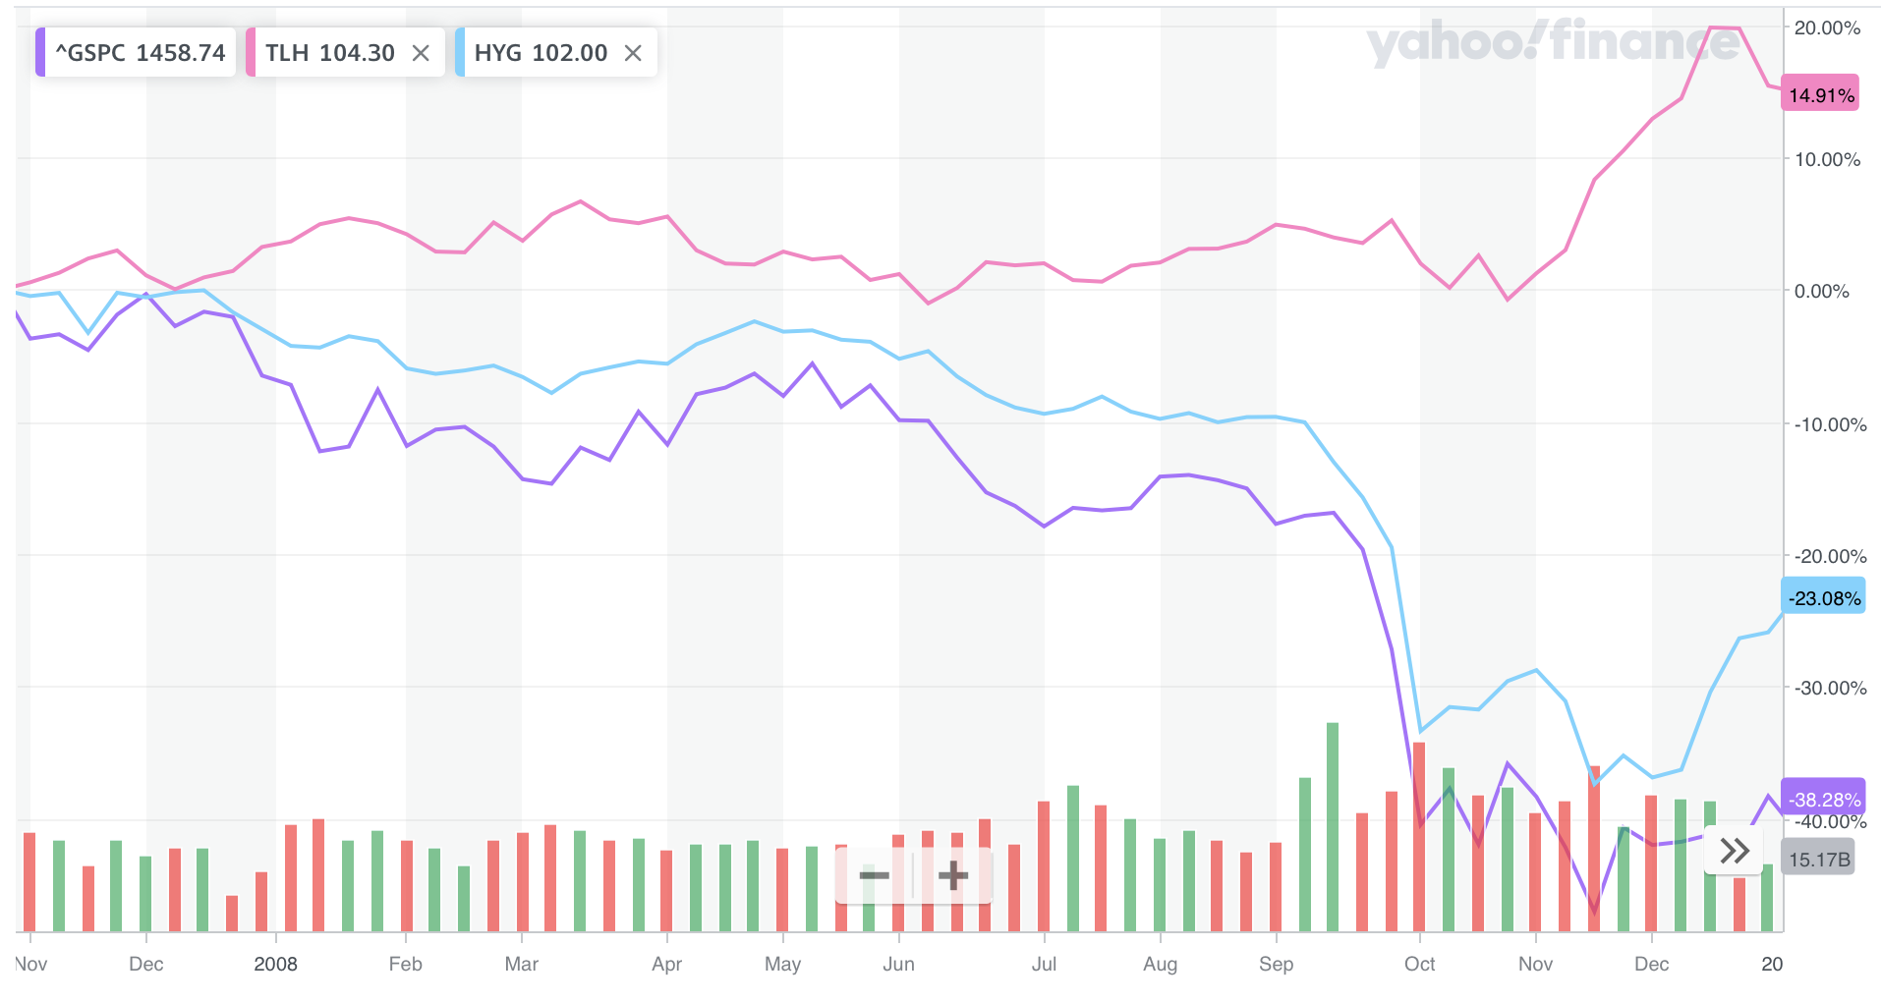
When markets become ”risk-off”, there is a flight to quality
In March 2020,
as equities fell {^GSPC: S&P500}
high yield bond prices fell {HYG: iShares iBoxx High Yield Corporate Bond ETF}
and Treasuries rallied {TLH: iShares 10-20 year Treasury ETF}

Slide 12
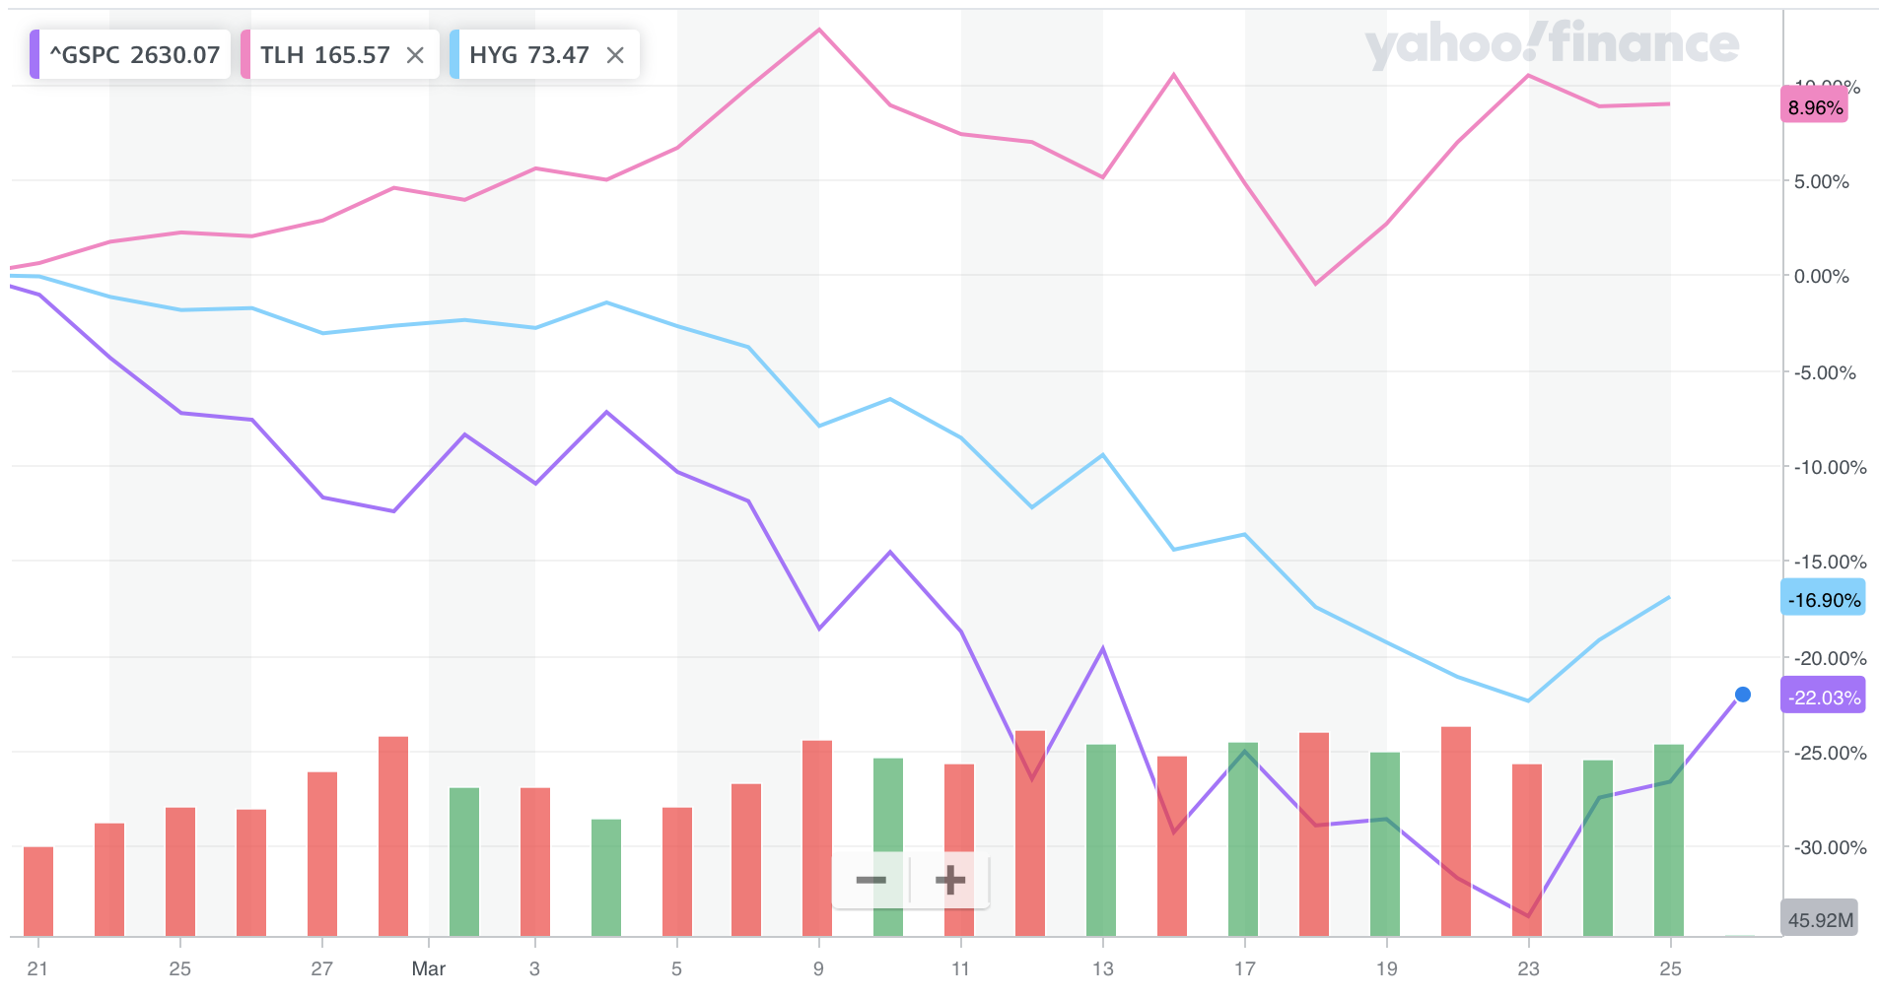
But sometimes the Markets behave strangely!
The behavior through March 9th 2020 seems to follow our expectations
But what happened from March 9th to March 18th?
Breakout rooms

Slide 13
The Cash-Futures Basis Trade
When asset managers want to “go-long” ”interest rates” (i.e. be long bonds),
they sometimes do this by buying futures on Treasury bonds
Instead of buying the Treasury bonds
Why? Because they don’t have to fund the purchase of the bonds, and can instead just post margin when buying T-Bond futures
Because asset managers have bought the futures, they trade “rich” (i.e. at a higher price) versus the futures.
When that happens, hedge funds then execute the “Cash-Futures” Basis trade where
they buy the bonds and sell the futures,
and wait for the two to converge
https://www.federalreserve.gov/econres/notes/feds-notes/quantifying-treasury-cash-futures-basis-trades-20240308.html

Slide 14
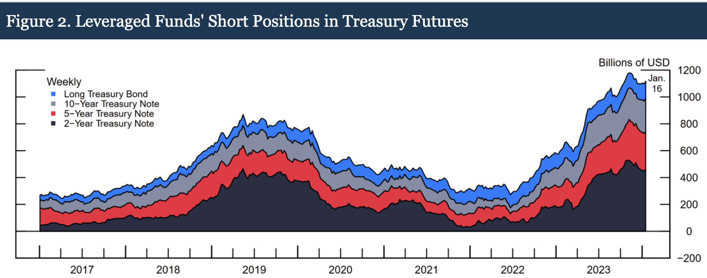
The Cash-Futures Basis Trade (cont’d)
To summarize: some hedge funds
are long bonds and are short the futures
The problem was that in March 2020, Hedge funds were losing on a variety of positions and so they had to meet margin calls.
One of the ways to generate cash to meet margin calls is to sell Treasuries, because they are very liquid!
But, if enough Treasuries are sold, Treasury prices may fall, and the Cash-Futures basis trade could “go upside down”, and so hedge funds may liquidate the entire position, which exacerbates the decline in Treasury prices.
https://www.federalreserve.gov/econres/notes/feds-notes/quantifying-treasury-cash-futures-basis-trades-20240308.html

Slide 15
What is a mortgage?
A loan from a lender (usually a bank) to a borrower, where the loan is collateralized by the borrower’s home
If the borrower defaults (stops paying back interest and principal), the lender repossesses the home and sells it*
Question: what are the risks associated with a mortgage?
Down payment
from borrower
At the time the borrower buys a home, the bank will lend an amount less than the price of the home
To buy the home, the borrower has to contribute a “down payment”
House
price
Mortgage
from bank
* This is a simplified explanation of a complex process, which varies from state to state based on state laws.

Slide 16
Risk#1: Credit Risk
The lender takes on credit risk, a function of
Ability of lender to pay back the loan
Home prices
Borrower’s
“equity”
Increased.
Home prices rise
Time of Purchase
Down payment =
The amount of
“equity” the borrower
has in this transaction
at time of purchase
Borrower’s
“equity”
is wiped out.
Borrower is
“underwater”
this amount
Home prices fall

Slide 17
Risk#1: Credit Risk
1950 - June 2006:
Question: how much risk does bank take if borrower buys $1mm home June 2006. Two cases:
requires 30% down payment ($300,000 down, $700,000 loan)
requires 3% ($30,000 down, $970,000 loan)
Source: Robert J. Shiller
Source: http://www.econ.yale.edu/~shiller/data.htm
Prof’s Spreadsheet: Robert Shiller Home Price History 202403.xlsx

Slide 18
Risk#1: Credit Risk
1950 – Feb 2012:
30% down: $ 26,000 positive equity (= $1,000,000*(1 - 27.4%) - $700,000)
3% down: $244,000 underwater (= $1,000,000*(1 - 27.4%) - $970,000)
-27.4%
Source: Robert J. Shiller
Source: http://www.econ.yale.edu/~shiller/data.htm
Prof’s Spreadsheet: Robert Shiller Home Price History 202403.xlsx

Slide 19
Risk#1: Credit Risk
As of Sept 2023, nominal home prices have more than recovered
But looking at nominal prices over long periods of time is misleading. It’s important to adjust for inflation
As of 2023, home prices had recovered on an inflation-adjusted basis.
Source: Robert J. Shiller
Source: http://www.econ.yale.edu/~shiller/data.htm
Fig3-1.xls
Prof’s Spreadsheet: Robert Shiller Home Price History 202403.xlsx

Slide 20
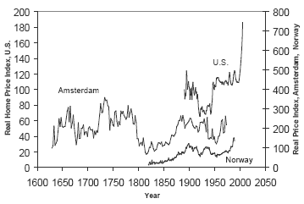
Risk#1: Credit Risk
Prices tend to track inflation over long periods of time
The Great Depression led to the creation of GSE’s
Source: Robert J. Shiller
Source: http://www.econ.yale.edu/~shiller/data.htm

Slide 21
Reducing Risk#1
Government Sponsored Entities (GSE) reduce the risk for investors in “Agency” securities
For residential mortgages and also commercial mortgages
Three agencies
FNMA (“Fannie Mae”)
FHLMC (“Freddie Mac”)
GNMA (“GinnieMae”)
Created by Acts of Congress to support homeownership
Replaces borrower credit with Agency credit
How: the agency guarantees the borrowers perform on their mortgages
Fannie Mae and Freddie Mac are/were private companies, have implicit Government protection
GNMA is a part of the U.S. Government, and GNMA MBS are backed by the full faith and credit of the U.S. Government
Fannie Mae and Freddie Mac are also the largest investors in mortgage-backed securities (pass-throughs, CMOs, also residential ABS)

Slide 22
Mortgage-Backed Securities (MBS)
An MBS is a security that receives cash flows which come from a “pool” of mortgages
From a credit risk perspective, there are two major categories: Agency and Non-Agency
Agency
Sponsored by a GSE (GNMA, FNMA or FHLMC)
Most Agency MBS, the principal and interest are guaranteed
There are also Agency MBS that are not guaranteed, called “Credit Retention Securities” *
Non-Agency
Sponsored / structured by a financial institution like Wells Fargo, Bank of America, JPMorgan, Citibank, etc.
* There are loss-sharing securities. CRT’s are a recent innovation, and much smaller amounts of these loss-sharing securities have been issued compared to the amounts of guaranteed securities

Slide 23
Mortgage-Backed Securities (MBS)
From the perspective of the structure of the MBS:
Agency
Pass-Throughs
The most liquid market
Simplest structure, just passes the mortgage cash flows through to investors
CMOs(Collateral Mortgage Obligations)
Structured products backed by Agency pass-throughs
Redirects prepayment and interest rates risks across various “tranches”
The characteristics of CMOs are often tailored to investors’ wishes

Slide 24
Agency Pass-through vs. Agency CMO
Gather mortgage loans and put them in a trust
The trust issues a liability collateralized by the loans
A CMO slices and dices the cash flows further
Guaranteed by an Agency
Mortgage #1
Pool
Pass-Through
CMO
Mortgage #2
10,000 mortgages
Security
Security A
Security B
*
*
*
*
Mortgage #3
Security F
Mortgage #10,000

Slide 25
Mortgage-Backed Securities
The structure of Non-Agency MBS:
CMOs
AAA tranches are created by allocating collateral losses to subordinated tranches
Residential ABS
Sub-prime mortgages and manufactured housing
Deal structures are different from typical Agency CMOs

Slide 26
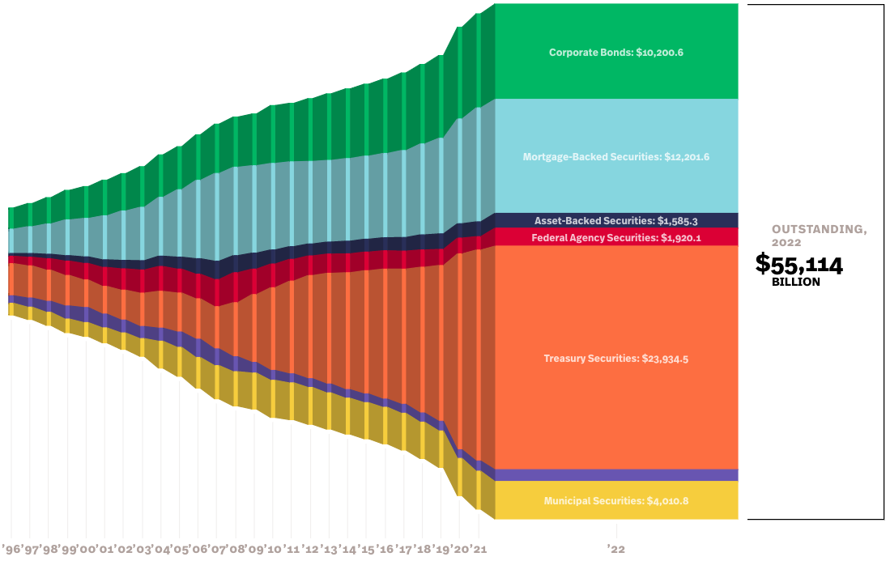
The U.S. Fixed Income securities markets (outstanding)
Largest outstandings: US Treasuries (~$24Bn), MBS ($12Bn), then Corporate Bonds (~$10Bn)
MBS are the original source of securitization technology; helpful in understanding other types of securitizations e.g. ABS (auto, credit card, home eqty, manufacturing, student loans; USD denominated CDOs)
Source: https://www.sifma.org/resources/research/fixed-income-chart/

Slide 27
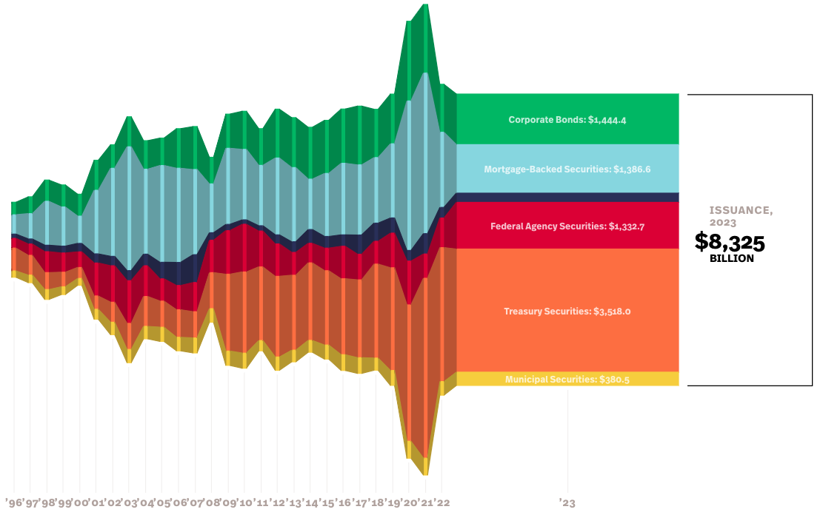
The U.S. Fixed Income securities markets (issuance)
Notice the large amount of Treasuries issued in 2020 and 2021 (financed stimulus during the Pandemic)
Source: https://www.sifma.org/resources/research/fixed-income-chart/

Slide 28
U.S. RMBS, non-Mortgage-related Issuance $Bn
Note large issuance of Non-Agency mortgage 2002-2007; key driver of the Financial Crisis
Note: jump in issuance of Agency MBS 2020, 2021.
Note: drop off in 2022, 2023
Note massive issuance of CDO’s in 2004-2007; key driver of the Financial Crisis
The majority of issuance of CDO/CLO in recent years has been CLO’s, not CDO’s.
Note the drop off in 2022, 2023
Why?
Why?
Source: https://www.sifma.org/resources/archive/research/statistics/ download two spreadsheets:
Spreadsheet: US-Mortgage-Backed-Securities-Statistics-SIFMA.xlsx, US-Asset-Backed-Securities-Statistics-SIFMA.xlsx

Slide 29
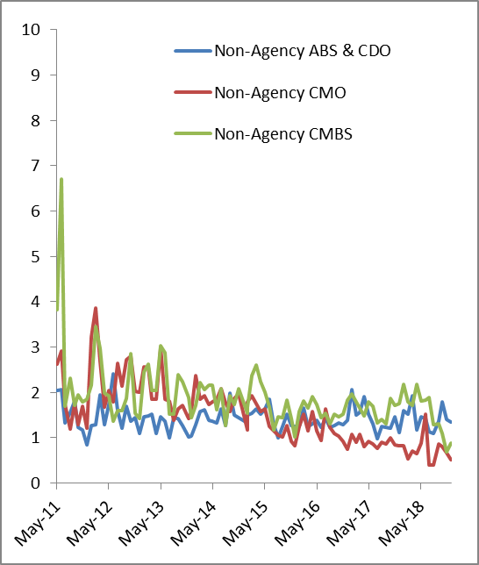
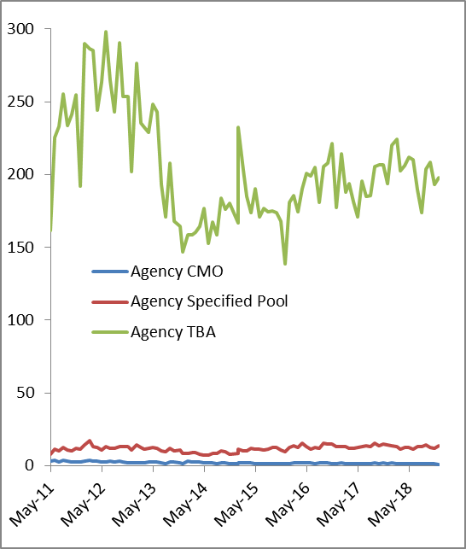
RMBS Average Daily Trading Volume ($Bn)
Agency TBAs are the most liquid instrument
Agency Specified Pools are much less liquidly traded
To be announced, or TBA in bond trading, is a term that describes forward-settling of mortgage-backed securities (MBS) trades. Pass-through securities issued by Freddie Mac, Fannie Mae, and Ginnie Mae trade in the TBA market, and the term TBA is derived from the fact that the actual mortgage-backed security that will be delivered to fulfill a TBA trade is not designated at the time the trade is made. These securities are announced 48 hours prior to the established trade settlement date.
Source: http://www.sifma.org/research/statistics.aspx, filename: sf-us-sf-trading-volume-sifma.xls

Slide 30
Basics of Mortgage Loans
Traditional loan
Matures in 30-years
Fixed rate
Fully amortizing
Principle and interest paid back monthly
Level payments
Prepayable at any time (generally without a prepayment penalty)

Slide 31
Risk#2a: Interest Rate
To lend to a borrower, a bank itself has to borrow money, typically via deposits
The bank profits on the difference between the interest rates
lends fixed-rate based on the “long” end of the curve
borrows at the “short” end of the curve based on short-term interest rates

Slide 32
Risk#2a: Interest Rate Risk (bond duration, convexity)
The borrower’s rate is fixed, but short-term rates can change
In the late 1970’s short term rates rose from ~5% to 20%!
Source: Federal Reserve

Slide 33
Other kinds of Mortgages
Variations
15-year, 20-year
Hybrid ARM
3/1, 5/1, 7/1, 10/1
Caps (initial, periodic, lifetime) e.g. 5/2/5
Adjustable Rate Mortgage (ARMs)
Index (1mth LIBOR, 1yr Treasury) + spread
Caps
Interest-only

Slide 34
Mortgage Basics (Pre-Crisis)
Low-doc (e.g. “stated income”, “stated assets”)
Sub-prime (based on FICO, LTV, DTI)
Affordability features:
Teaser Rate
Option ARM

Slide 35
Mortgage Cash Flows without prepayment
Fixed rate level-payment fully-amortizing mortgage:
Initial mortgage principal (or balance) is M₀ dollars
Monthly payments of B dollars (in “arrears” i.e. at the end of the month)
Coupon rate is c per payment period
n repayment periods
After the n payments, the mortgage principal has been paid off
Each payment includes both interest and some principal
If M_{k} denotes the mortgage principal (or balance) remaining after the k^{th} period, then:
M_{k} = (1 + c)M_{k−1} − B for k = 1, 2, . . . , n (1)
with M_{n} = 0.

Slide 36
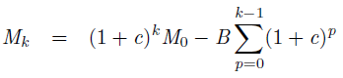
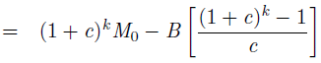
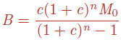
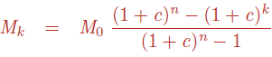
Solve for monthly payment B, remaining Principal M_{k}
Can iterate (1) to get:
(2)
But M_{n} = 0, so (3)
Substitute (3) back into (2) to get: (4)
Interest paid at time k is just:
Similarly, Principal paid at time k:

Slide 37
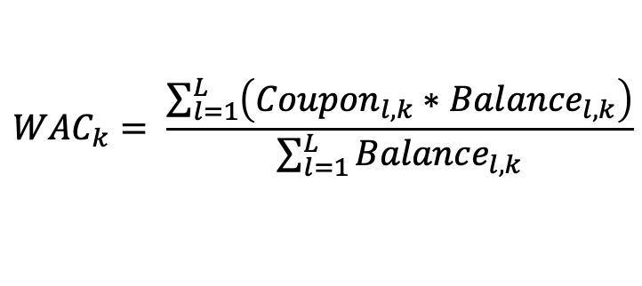
Loan (or pool) characteristics – clarifications
Assuming there are L loans*, then
Coupon_{l,k} refers to the coupon on loan l at time k ,
Balance_{l,k} refers to the outstanding balance for loan l at time k,
and:
Weighted Average Coupon (across all the Loans, evaluated at time k):
As time passes, the balances of different loans will almost certainly decrease at different rates. Therefore, even though the coupon for a fixed-rate loan won’t change, the WAC of a pool will almost certainly change through time. Also, not all mortgages are fixed-rate loans; they may be “hybrids” or adjustable rate mortgages (“ARM”s).
$${WAC}_{k}= \frac{\sum_{l=1}^{L}{\left({Coupon}_{l,k}∗{Balance}_{l, k}\right)}}{\sum_{l=1}^{L}{{Balance}_{l, k}}}$$
* Note: “loan” could be used interchangeably with “pool”

Slide 38
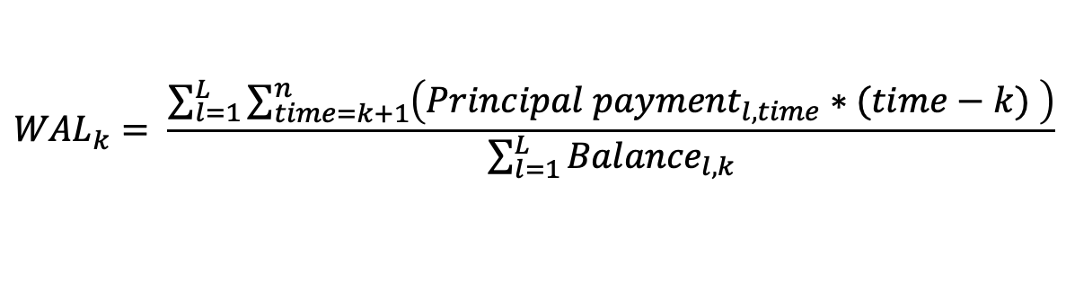
Loan (or pool) characteristics – clarifications
Weighted Average Life (across all the Loans 1 to L , evaluated at time k):
As time passes, the WAL will decrease.
(Note: that at time k, the sum of future Principal payments for any one loan l would equal the Balance for that loan at time k.)
$${WAL}_{k}= \frac{\sum_{l=1}^{L}{\sum_{time=k+1}^{n}{\left({Principal payment}_{l,time}∗(time−k) \right)}}}{\sum_{l=1}^{L}{{Balance}_{l, k}}}$$
* Note: “loan” could be used interchangeably with “pool”

Slide 39
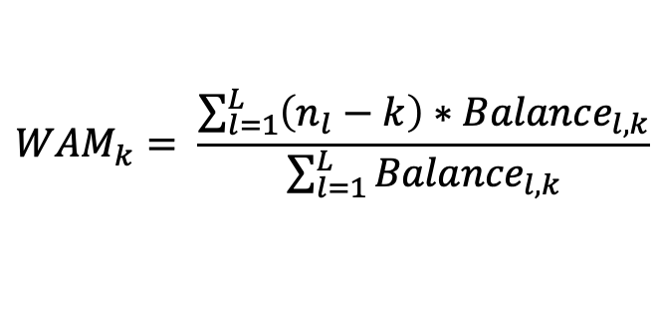
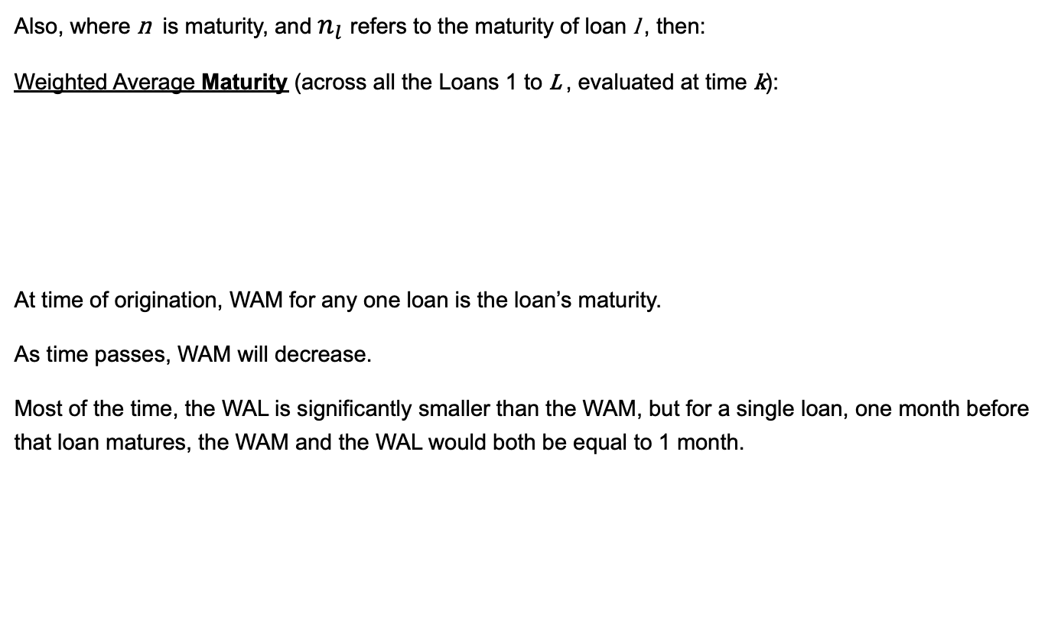
Loan (or pool) characteristics – clarifications
Also, where n is maturity, and $n_{l}$refers to the maturity of loan l , then:
Weighted Average Maturity (across all the Loans 1 to L , evaluated at time k):
At time of origination, WAM for any one loan is the loan’s maturity.
As time passes, WAM will decrease.
Most of the time, the WAL is significantly smaller than the WAM, but for a single loan, one month before that loan matures, the WAM and the WAL would both be equal to 1 month.
$${WAM}_{k}= \frac{\sum_{l=1}^{L}{\left(n_{l}−k\right)∗{Balance}_{l, k}}}{\sum_{l=1}^{L}{{Balance}_{l, k}}}$$
* Note: “loan” could be used interchangeably with “pool”

Slide 40
Principal through time
Principal declines to zero at maturity
30yr mortgage 4% coupon. At inception of the mortgage, the WAL was 18yrs, WAM was 30yrs.
(As time passes, the WAL and the WAM drop. For example, one month after inception, WAM is exactly 1 month smaller than it was at inception. WAL is roughly 1 month smaller than it was.)

Slide 41
Principal through time
15yr mortgage, 4% coupon
At inception: WAL 8.3 yrs; WAM 15 yrs

Slide 42
Monthly Principal Payment, Interest Payment
30yr mortgage 4% coupon
Required mthly payment: $477. Initially, majority of payment is interest
(Note that the required mthly payment does not change, even if a borrower chooses to pay off part of the mortgage early “curtail”.)

Slide 43
Monthly Principal Payment, Interest Payment
15yr mortgage 4% coupon
Required mthly payment $739. In contrast to the previous example, majority of payment is principal

Slide 44
Risk#2b: Prepayment Risk
For Agency-guaranteed mortgages, the borrower can repay his mortgage and not pay a prepayment penalty
Fixed Rate Mortgage (FRM)
When interest rates fall, the borrower has the benefit of being able to refinance: borrow at the current (lower) mortgage rate and repay existing mortgage loan
Floating Rate Mortgages
Borrower can refinance to a new hybrid or to Fixed
Borrower has the ability to "permanently" lock-in the benefit of low rates by refinancing into a fixed rate loan

Slide 45
Risk#2b: Price vs Yield
Mortgages are negatively convex

Slide 46
Risk#2b: Derivative analogy
Bond portion: obligation to pay principal and interest in monthly installments
Option portion: opportunity to "call" (purchase) the bond at a price of par, at any time
Value of a mortgage loan is the value of the bond minus the value of the option
Lender is long the bond and short the option
Borrower is short the bond and long the option

Slide 47
Homework
Build Mortgage calculator (without prepayment) in Excel
Input parameters: Initial Principal, Annual Coupon, Maturity(months)
Should be able to handle Maturity from 1 to 360 mths
Generate
a dynamic table with one row for each month
Graphs: Beginning Principal, Cumulative Interest Paid, Scheduled Principal Payment, Interest Payment
Scenario Analyses:
Graph WAL as a function of Maturity from 1 to 360 mths
Graph a 2-dimensional column chart of Cum. Int. Paid as a function of Annual Coupon from 4% to 9% and Maturities = 10, 15 and 30 years

Slide 48
Appendix
Additional stuff you need to know if you work in this field

Slide 49
An (incomplete) history
1929: Great Depression begins
1934: Federal Housing Administration
1938: Federal National Mortgage Association (FNMA)
1948: FNMA purchases its first VA loan
1949: First secondary market transaction between two S&Ls
1954: FNMA converted to a private corp.
1957: Federal Home Loan Bank Board permits purchases and sales of mortgage loan participations
1968: Government National Mortgage Association (GNMA) is spun-off from FNMA
1970: GNMA guarantees first “pass-through” MBS backed by FHA/VA loans
1970: Federal Home Loan Mortgage Corporation (FHLMC)
1971: FHLMC introduces conventional mortgage pass-through
1971-1977: RMBS market develops; all deals from GNMA and FHLMC
1977: First private-label RMBS
1977-1984: limited private-label RMBS activity
1983: FHLMC issues first CMO
1985 May: First auto loan ABS
1986: REMIC tax classification
1987 January: First credit card ABS
1988: Basel I Capital Accord
1989: FIRREA creates Office of Thrift Supervision
1989: Resolution Trust Corporation

